Slide 1
William Stallings
Data and Computer Communications
7th Edition
Chapter 3
Data Transmission

Slide 2
Terminology (1)
Transmitter
Receiver
Medium
  Guided medium
    e.g. twisted pair, optical fiber
  Unguided medium
    e.g. air, water, vacuum

Slide 3
Terminology (2)
Direct link
  No intermediate devices
Point-to-point
  Direct link
  Only 2 devices share link
Multi-point
  More than two devices share the link

Slide 4
Terminology (3)
Simplex
  One direction
    e.g. Television
Half duplex
  Either direction, but only one way at a time
    e.g. police radio
Full duplex
  Both directions at the same time
    e.g. telephone

Slide 5
Frequency, Spectrum and Bandwidth
Time domain concepts
  Analog signal
    Various in a smooth way over time
  Digital signal
    Maintains a constant level then changes to another constant level
  Periodic signal
    Pattern repeated over time
  Aperiodic signal
    Pattern not repeated over time

Slide 6
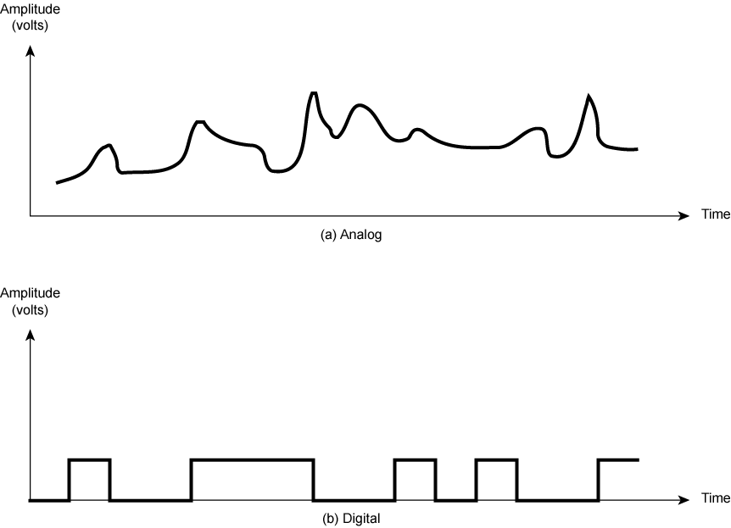
Analogue & Digital Signals

Slide 7
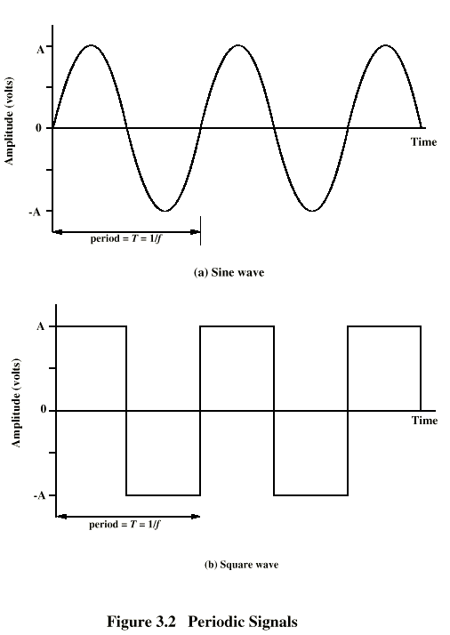
Periodic
Signals

Slide 8
Sine Wave
Peak Amplitude (A)
  maximum strength of signal
  volts
Frequency (f)
  Rate of change of signal
  Hertz (Hz) or cycles per second
  Period = time for one repetition (T)
  T = 1/f
Phase (φ)
  Relative position in time

Slide 9
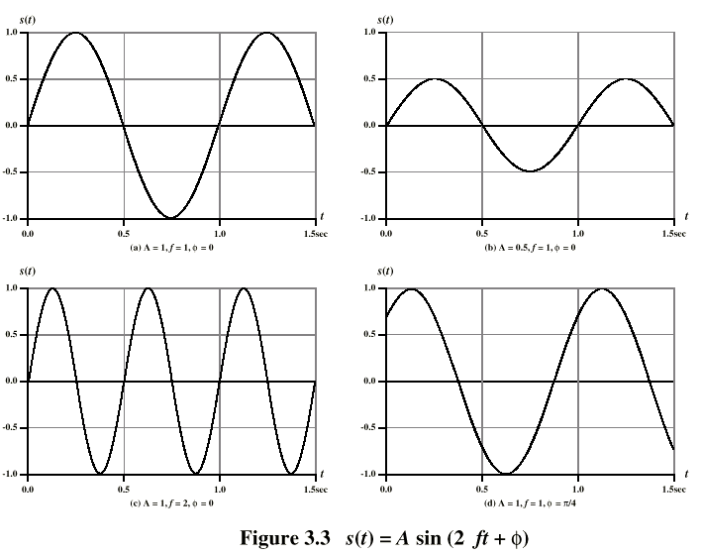
Varying Sine Waves s(t) = A sin(2πft +Φ)

Slide 10
Wavelength
Distance occupied by one cycle
Distance between two points of corresponding phase in two consecutive cycles
λ
Assuming signal velocity v
  λ = vT
  λf = v
  c = 3*10⁸ ms⁻¹ (speed of light in free space)

Slide 11
Frequency Domain Concepts
Signal usually made up of many frequencies
Components are sine waves
Can be shown (Fourier analysis) that any signal is made up of component sine waves
Can plot frequency domain functions

Slide 12
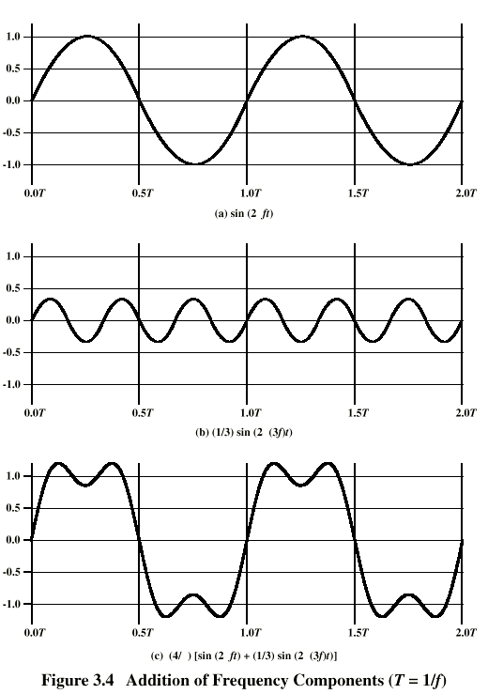
Addition of
Frequency
Components
(T=1/f)

Slide 13
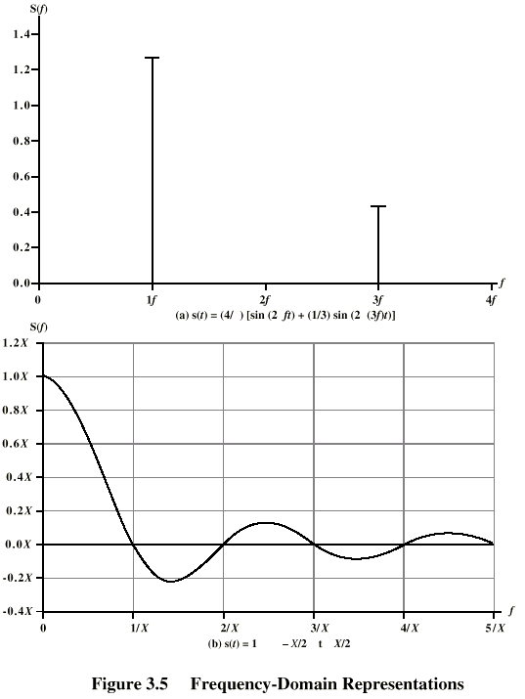
Frequency
Domain
Representations

Slide 14
Spectrum & Bandwidth
Spectrum
  range of frequencies contained in signal
Absolute bandwidth
  width of spectrum
Effective bandwidth
  Often just bandwidth
  Narrow band of frequencies containing most of the energy
DC Component
  Component of zero frequency

Slide 15
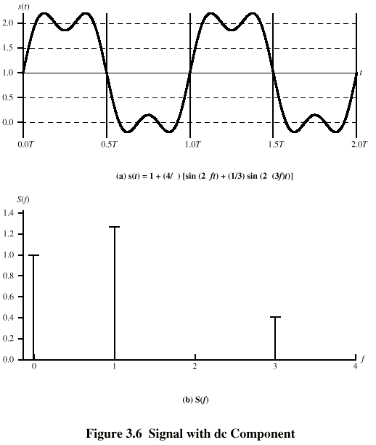
Signal with DC Component

Slide 16
Data Rate and Bandwidth
Any transmission system has a limited band of frequencies
This limits the data rate that can be carried

Slide 17
Analog and Digital Data Transmission
Data
  Entities that convey meaning
Signals
  Electric or electromagnetic representations of data
Transmission
  Communication of data by propagation and processing of signals

Slide 18
Analog and Digital Data
Analog
  Continuous values within some interval
  e.g. sound, video
Digital
  Discrete values
  e.g. text, integers

Slide 19
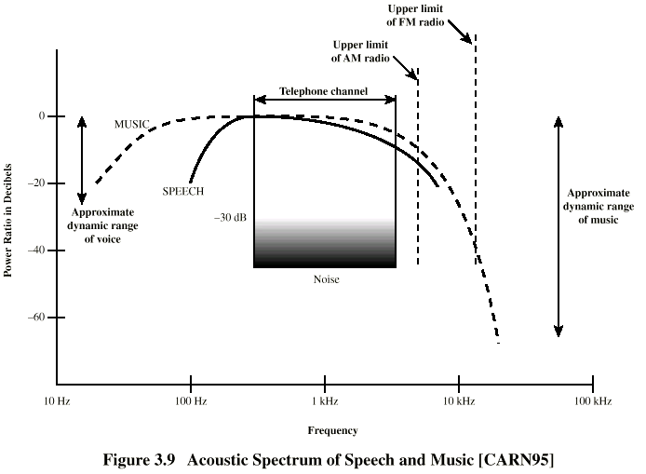
Acoustic Spectrum (Analog)

Slide 20
Analog and Digital Signals
Means by which data are propagated
Analog
  Continuously variable
  Various media
    wire, fiber optic, space
  Speech bandwidth 100Hz to 7kHz
  Telephone bandwidth 300Hz to 3400Hz
  Video bandwidth 4MHz
Digital
  Use two DC components

Slide 21
Advantages & Disadvantages of Digital
Cheaper
Less susceptible to noise
Greater attenuation
  Pulses become rounded and smaller
  Leads to loss of information

Slide 22
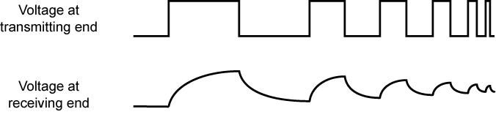
Attenuation of Digital Signals

Slide 23
Components of Speech
Frequency range (of hearing) 20Hz-20kHz
  Speech 100Hz-7kHz
Easily converted into electromagnetic signal for transmission
Sound frequencies with varying volume converted into electromagnetic frequencies with varying voltage
Limit frequency range for voice channel
  300-3400Hz

Slide 24
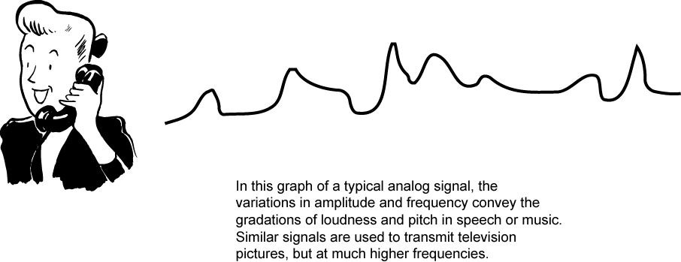
Conversion of Voice Input into Analog Signal

Slide 25
Video Components
USA - 483 lines scanned per frame at 30 frames per second
  525 lines but 42 lost during vertical retrace
So 525 lines x 30 scans = 15750 lines per second
  63.5μs per line
  11μs for retrace, so 52.5 μs per video line
Max frequency if line alternates black and white
Horizontal resolution is about 450 lines giving 225 cycles of wave in 52.5 μs
Max frequency of 4.2MHz

Slide 26
Binary Digital Data
From computer terminals etc.
Two dc components
Bandwidth depends on data rate

Slide 27
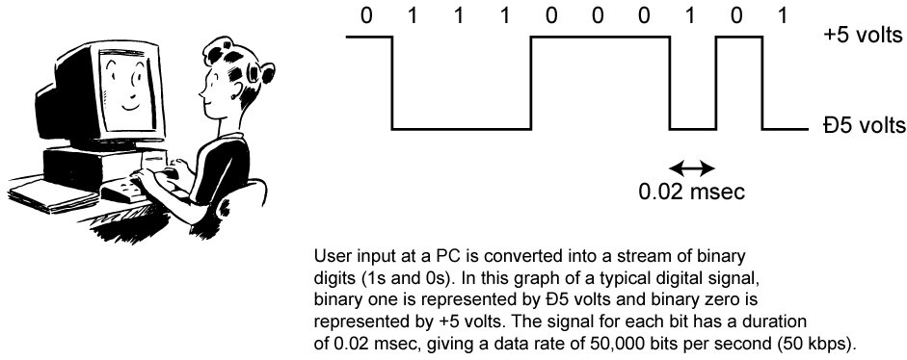
Conversion of PC Input to Digital Signal

Slide 28
Data and Signals
Usually use digital signals for digital data and analog signals for analog data
Can use analog signal to carry digital data
  Modem
Can use digital signal to carry analog data
  Compact Disc audio

Slide 29
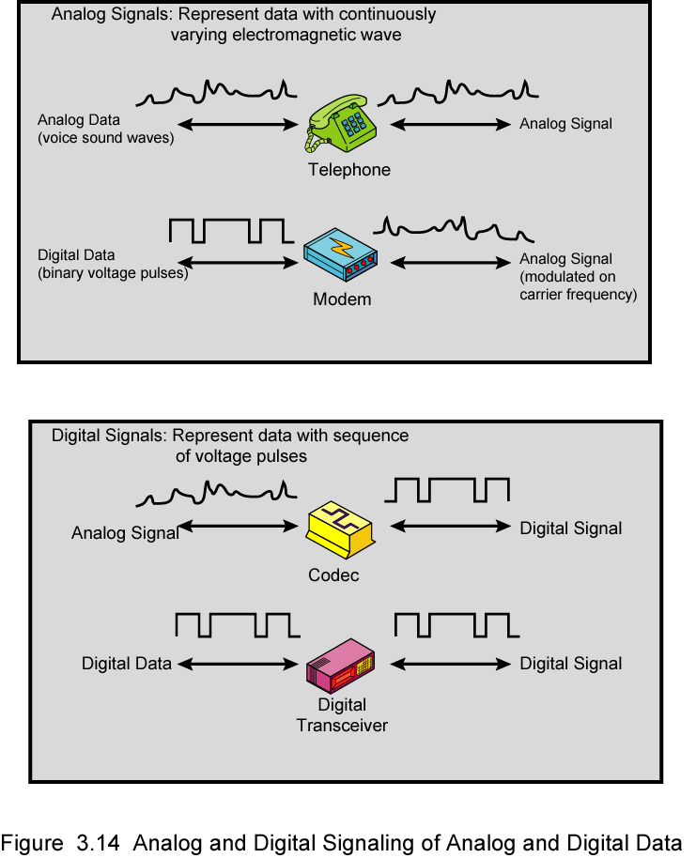
Analog Signals Carrying Analog and Digital Data

Slide 30
Digital Signals Carrying Analog and Digital Data

Slide 31
Analog Transmission
Analog signal transmitted without regard to content
May be analog or digital data
Attenuated over distance
Use amplifiers to boost signal
Also amplifies noise

Slide 32
Digital Transmission
Concerned with content
Integrity endangered by noise, attenuation etc.
Repeaters used
Repeater receives signal
Extracts bit pattern
Retransmits
Attenuation is overcome
Noise is not amplified

Slide 33
Advantages of Digital Transmission
Digital technology
  Low cost LSI/VLSI technology
Data integrity
  Longer distances over lower quality lines
Capacity utilization
  High bandwidth links economical
  High degree of multiplexing easier with digital techniques
Security & Privacy
  Encryption
Integration
  Can treat analog and digital data similarly

Slide 34
Transmission Impairments
Signal received may differ from signal transmitted
Analog - degradation of signal quality
Digital - bit errors
Caused by
  Attenuation and attenuation distortion
  Delay distortion
  Noise

Slide 35
Attenuation
Signal strength falls off with distance
Depends on medium
Received signal strength:
  must be enough to be detected
  must be sufficiently higher than noise to be received without error
Attenuation is an increasing function of frequency

Slide 36
Delay Distortion
Only in guided media
Propagation velocity varies with frequency

Slide 37
Noise (1)
Additional signals inserted between transmitter and receiver
Thermal
  Due to thermal agitation of electrons
  Uniformly distributed
  White noise
Intermodulation
  Signals that are the sum and difference of original frequencies sharing a medium

Slide 38
Noise (2)
Crosstalk
  A signal from one line is picked up by another
Impulse
  Irregular pulses or spikes
  e.g. External electromagnetic interference
  Short duration
  High amplitude

Slide 39
Channel Capacity
Data rate
  In bits per second
  Rate at which data can be communicated
Bandwidth
  In cycles per second of Hertz
  Constrained by transmitter and medium

Slide 40
Nyquist Bandwidth
If rate of signal transmission is 2B then signal with frequencies no greater than B is sufficient to carry signal rate
Given bandwidth B, highest signal rate is 2B
Given binary signal, data rate supported by B Hz is 2B bps
Can be increased by using M signal levels
C= 2B log₂M

Slide 41
Shannon Capacity Formula
Consider data rate,noise and error rate
Faster data rate shortens each bit so burst of noise affects more bits
  At given noise level, high data rate means higher error rate
Signal to noise ration (in decibels)
SNR_{db}⁼10 log₁₀ (signal/noise)
Capacity C=B log₂(1+SNR)
This is error free capacity

Slide 42
Required Reading
Stallings chapter 3

